Slide 1
Chapter 8:
Advanced Method Concepts

Slide 2
Objectives
Learn about parameter types and review mandatory value parameters.
Use ref parameters, out parameters, and parameter arrays.
Learn about overloaded methods.
Learn how to avoid ambiguous methods.
Use optional parameters.

Slide 3
Understanding Parameter Types
When you use a mandatory parameter, an argument for it is required in every method call.
There are four types of mandatory parameters:
Value parameters (declared without any modifiers).
Reference parameters (declared with the ref modifier).
Output parameters (declared with the out modifier).
Parameter arrays (declared with the params modifier).

Slide 4
Using Mandatory Value Parameters
When you use a value parameter in a method header, you indicate the parameter’s type and name.
The method receives a copy of the value passed to it.
The copy is stored at a different memory address than the actual parameter
Changes to value parameters never affect the original argument in the calling method.

Slide 5
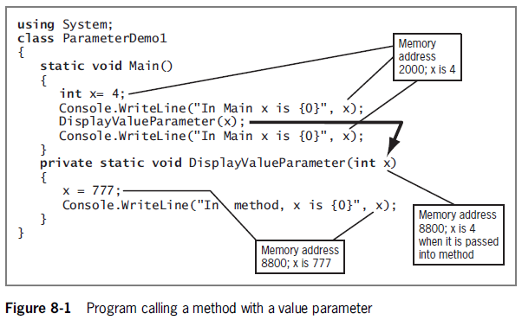
Using Mandatory Value Parameters

Slide 6
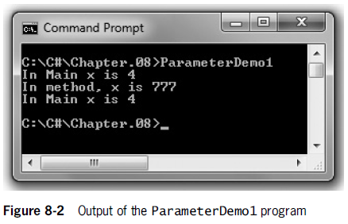
Using Mandatory Value Parameters

Slide 7
Using Reference Parameters, Output Parameters, and Parameter Arrays
Reference parameters and output parameters
Have memory addresses that are passed to a method, allowing the method to alter the original variables.
Differences
Reference parameters need to contain a value before calling the method.
Output parameters do not need to contain a value.
Reference and output parameters act as aliases for the same memory location occupied by the original passed variable.

Slide 8
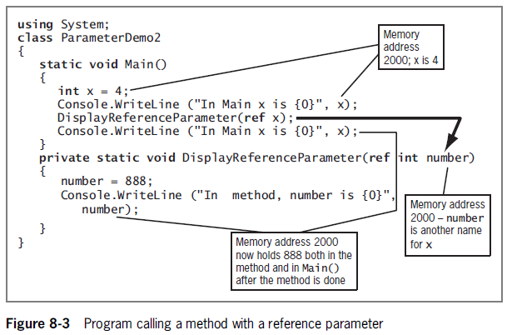
Using a ref Parameter

Slide 9
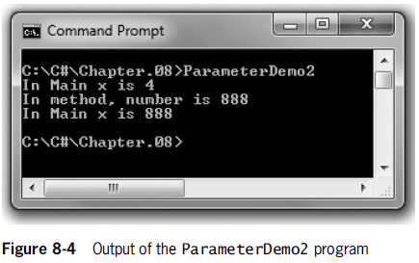
Using a ref Parameter

Slide 10
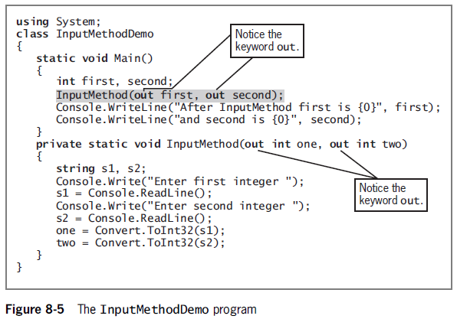
Using an out Parameter

Slide 11
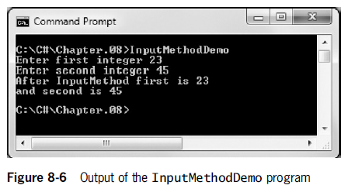
Using an out Parameter

Slide 12
Using Reference and Output Parameters
The advantage of using reference and output parameters:
A method can change multiple variables.
The disadvantage of using reference and output parameters:
They allow multiple methods to have access to the same data, weakening the “black box” paradigm.

Slide 13
Using the TryParse() Methods
The TryParse() methods are an alternative to the Convert() and Parse() methods from Chapter 2.
TryParse() requires two parameters:
The value to be converted.
An out parameter to hold the result.
TryParse() returns a Boolean value.

Slide 14
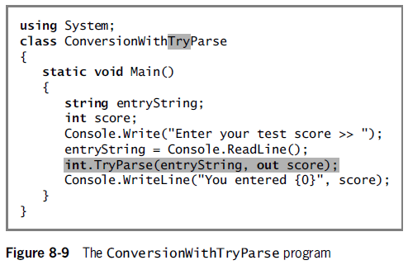
Using the TryParse() Methods

Slide 15
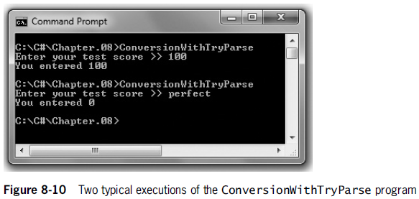
Using the TryParse() Methods

Slide 16
Using Parameter Arrays
Parameter array
A local array declared within the method header by using the keyword params
Used when you don’t know how many arguments of the same type you might eventually send to a method
No additional parameters are permitted after the params keyword
Only one params keyword is permitted in a method declaration

Slide 17
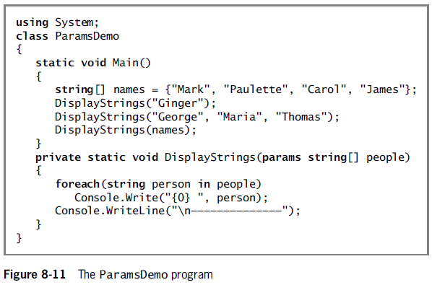
Using Parameter Arrays

Slide 18
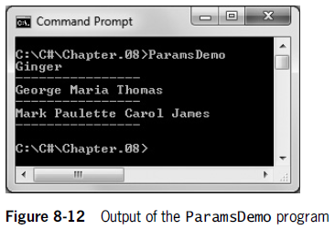
Using Parameter Arrays

Slide 19
Overloading Methods
Overloading involves using one term to indicate diverse meanings.
When you overload a C# method by writing multiple methods (all) with a shared name.
The compiler understands your meaning based on the arguments you use with the method.
Methods are overloaded correctly when they have the same identifier but different parameter lists.

Slide 20
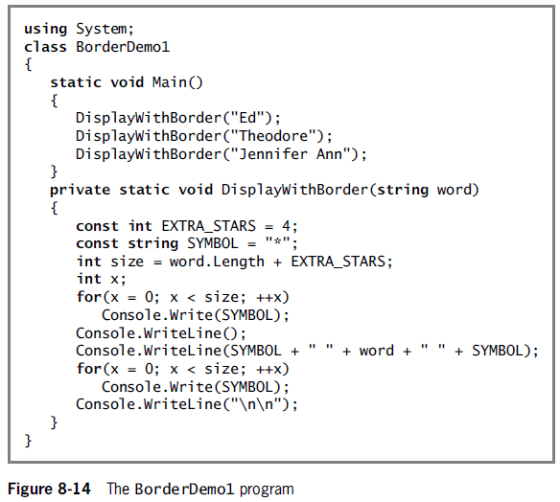
Overloading Methods

Slide 21
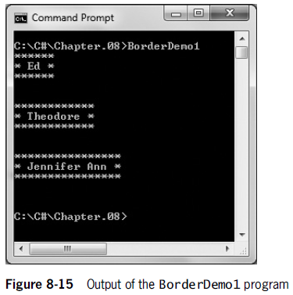
Overloading Methods

Slide 22
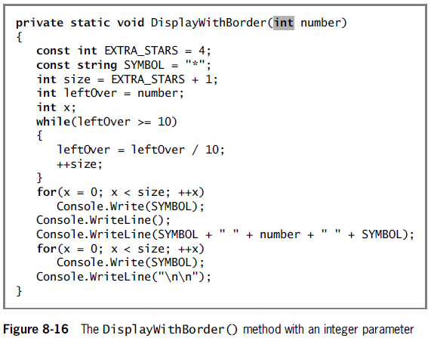
Overloading Methods

Slide 23
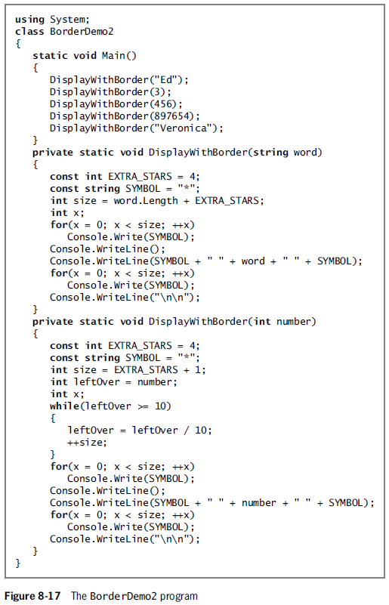

Slide 24
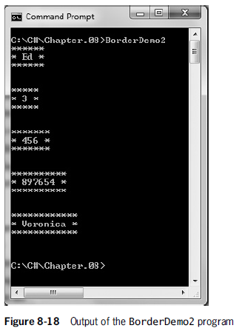
Overloading Methods

Slide 25
Understanding Overload Resolution
Overload resolution is used by C# to determine which method to execute when a method call could execute multiple overloaded methods.
Applicable methods are a set of methods that can accept a call with a specific list of arguments.
Betterness rules are rules that determine which method version to call.
Similar to the implicit data type conversion rules.

Slide 26
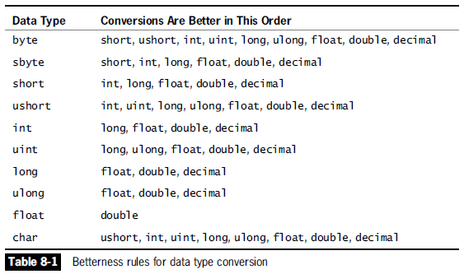
Understanding Overload Resolution

Slide 27
Discovering Built-In Overloaded Methods
When you use the IDE to create programs, Visual Studio’s IntelliSense features provide information about methods you are using

Slide 28
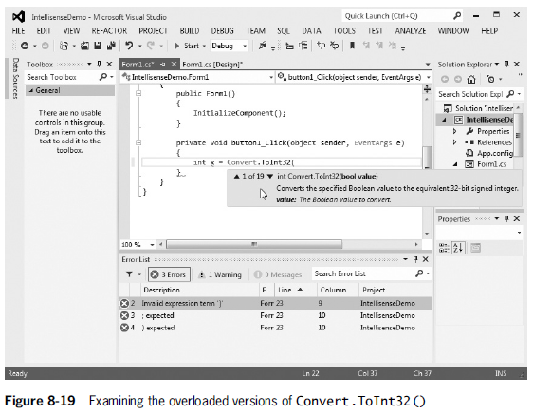

Slide 29
Avoiding Ambiguous Methods
Ambiguous method
A situation in which the compiler cannot determine which method to use
Occurs when you overload methods
Methods with identical names that have identical parameter lists but different return types are not overloaded

Slide 30
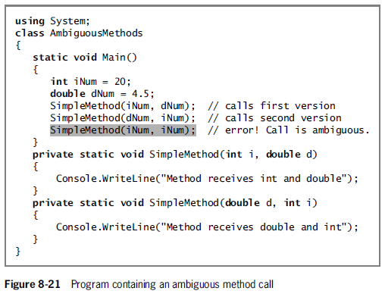
Avoiding Ambiguous Methods

Slide 31
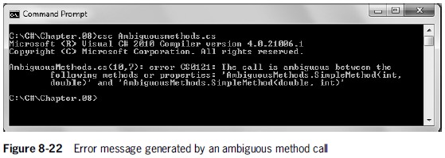
Avoiding Ambiguous Methods

Slide 32
Using Optional Parameters
An optional parameter to a method is one for which a default value is automatically supplied if you do not explicitly send one as an argument.
Make a parameter optional by providing a value for it in the method declaration.
Only value parameters can be given default values.
Any optional parameters in a parameter list must follow all mandatory parameters.

Slide 33
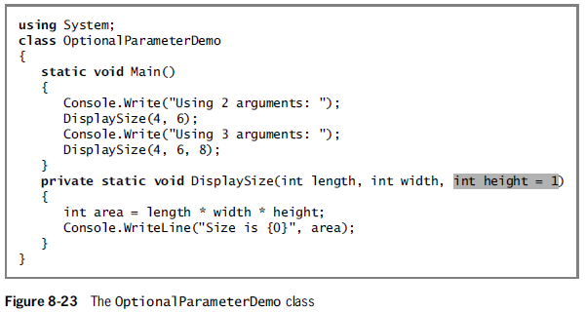
Using Optional Parameters

Slide 34
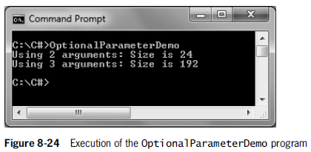
Using Optional Parameters

Slide 35
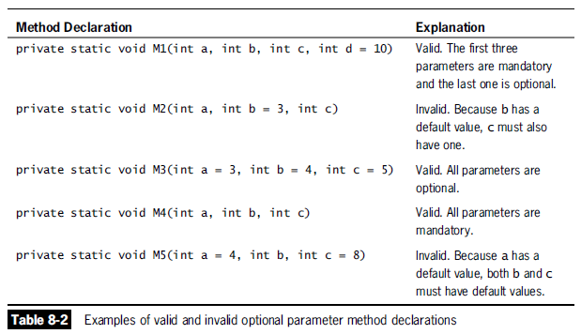
Using Optional Parameters

Slide 36
Leaving Out Unnamed Arguments
When calling a method with optional parameters and you are using unnamed arguments, you must leave out any arguments to the right of the last one used.
In other words, once an argument is left out, you must leave out all the arguments that would otherwise follow.
An example method:
private static void Method1(int a, char b, int c = 22, double d = 33.2)

Slide 37
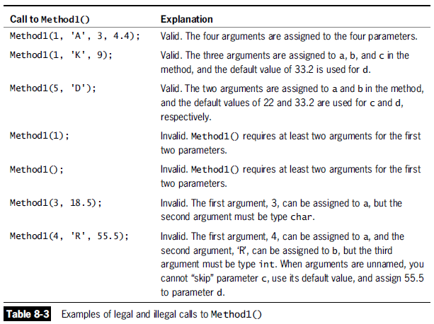

Slide 38
Using Named Arguments
Leave out optional arguments in a method call if you pass the remaining arguments by name
Named arguments appear in any order
But must appear after all the unnamed arguments have been listed
Name an argument using its parameter name and a colon before the value
Example method:
private static void Method1(int a, char b, int c = 22, double d = 33.2)

Slide 39
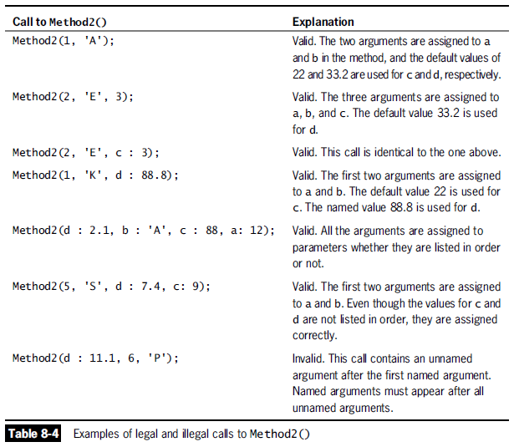

Slide 40
Advantages to Using Named Arguments
Added flexibility with method calls.
Named arguments can be coded in any order as long as they follow all the unnamed arguments
Can result in fewer overloaded methods.
Can aid in self-documentation.

Slide 41
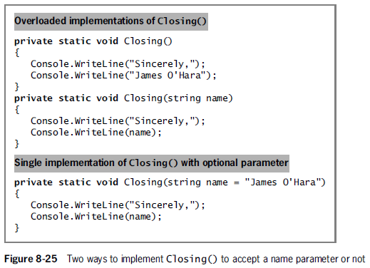
Advantages to Using Named Arguments

Slide 42
Disadvantages to Using Named Arguments
Implementation hiding is compromised.
Changes to the called method could cause problems and require changes to the calling method or program.

Slide 43
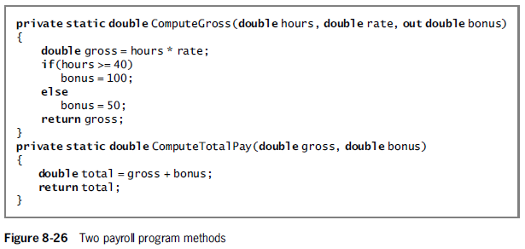
Disadvantages to Using Named Arguments

Slide 44
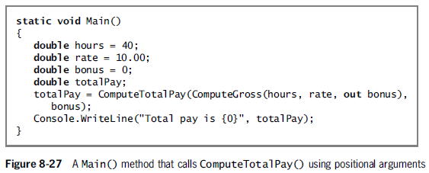
Disadvantages to Using Named Arguments

Slide 45
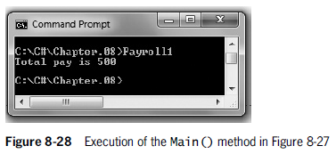
Disadvantages to Using Named Arguments

Slide 46
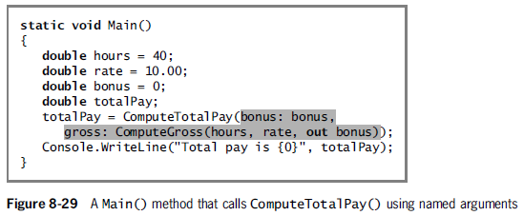
Disadvantages to Using Named Arguments

Slide 47
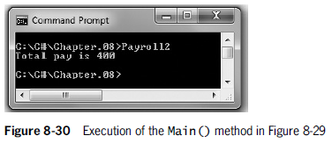
Disadvantages to Using Named Arguments

Slide 48
Overload Resolution with Named and Optional Arguments
Named and optional arguments affect overload resolution.
Rules for betterness on argument conversions are applied only for arguments that are given explicitly.
If two signatures are equally good, the signature that does not omit optional parameters is considered better.

